Slide 1
How to submit a paper to a journal?
Presented by Yujia Zhang
USC Mark and Mary Stevens Neuroimaging and Informatics Institute
USC Laboratory of Neuroimaging
loni.usc.edu

Slide 2
Choose a Journal
1. Make sure your topic falls in their aims and scope
USC Mark and Mary Stevens Neuroimaging and Informatics Institute
USC Laboratory of Neuroimaging
loni.usc.edu

Slide 3
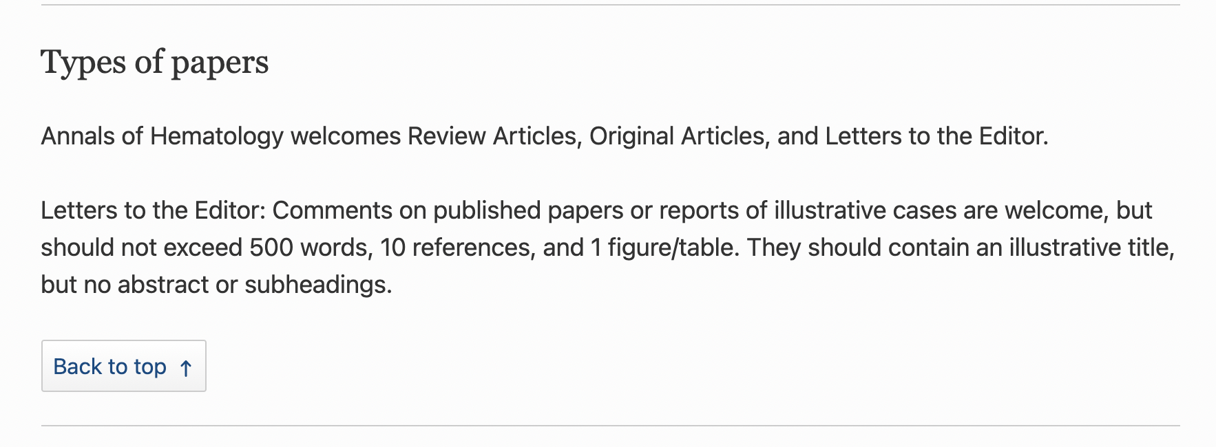
Choose a Journal
2. Make sure they accept your type of paper
USC Mark and Mary Stevens Neuroimaging and Informatics Institute
USC Laboratory of Neuroimaging
loni.usc.edu

Slide 4
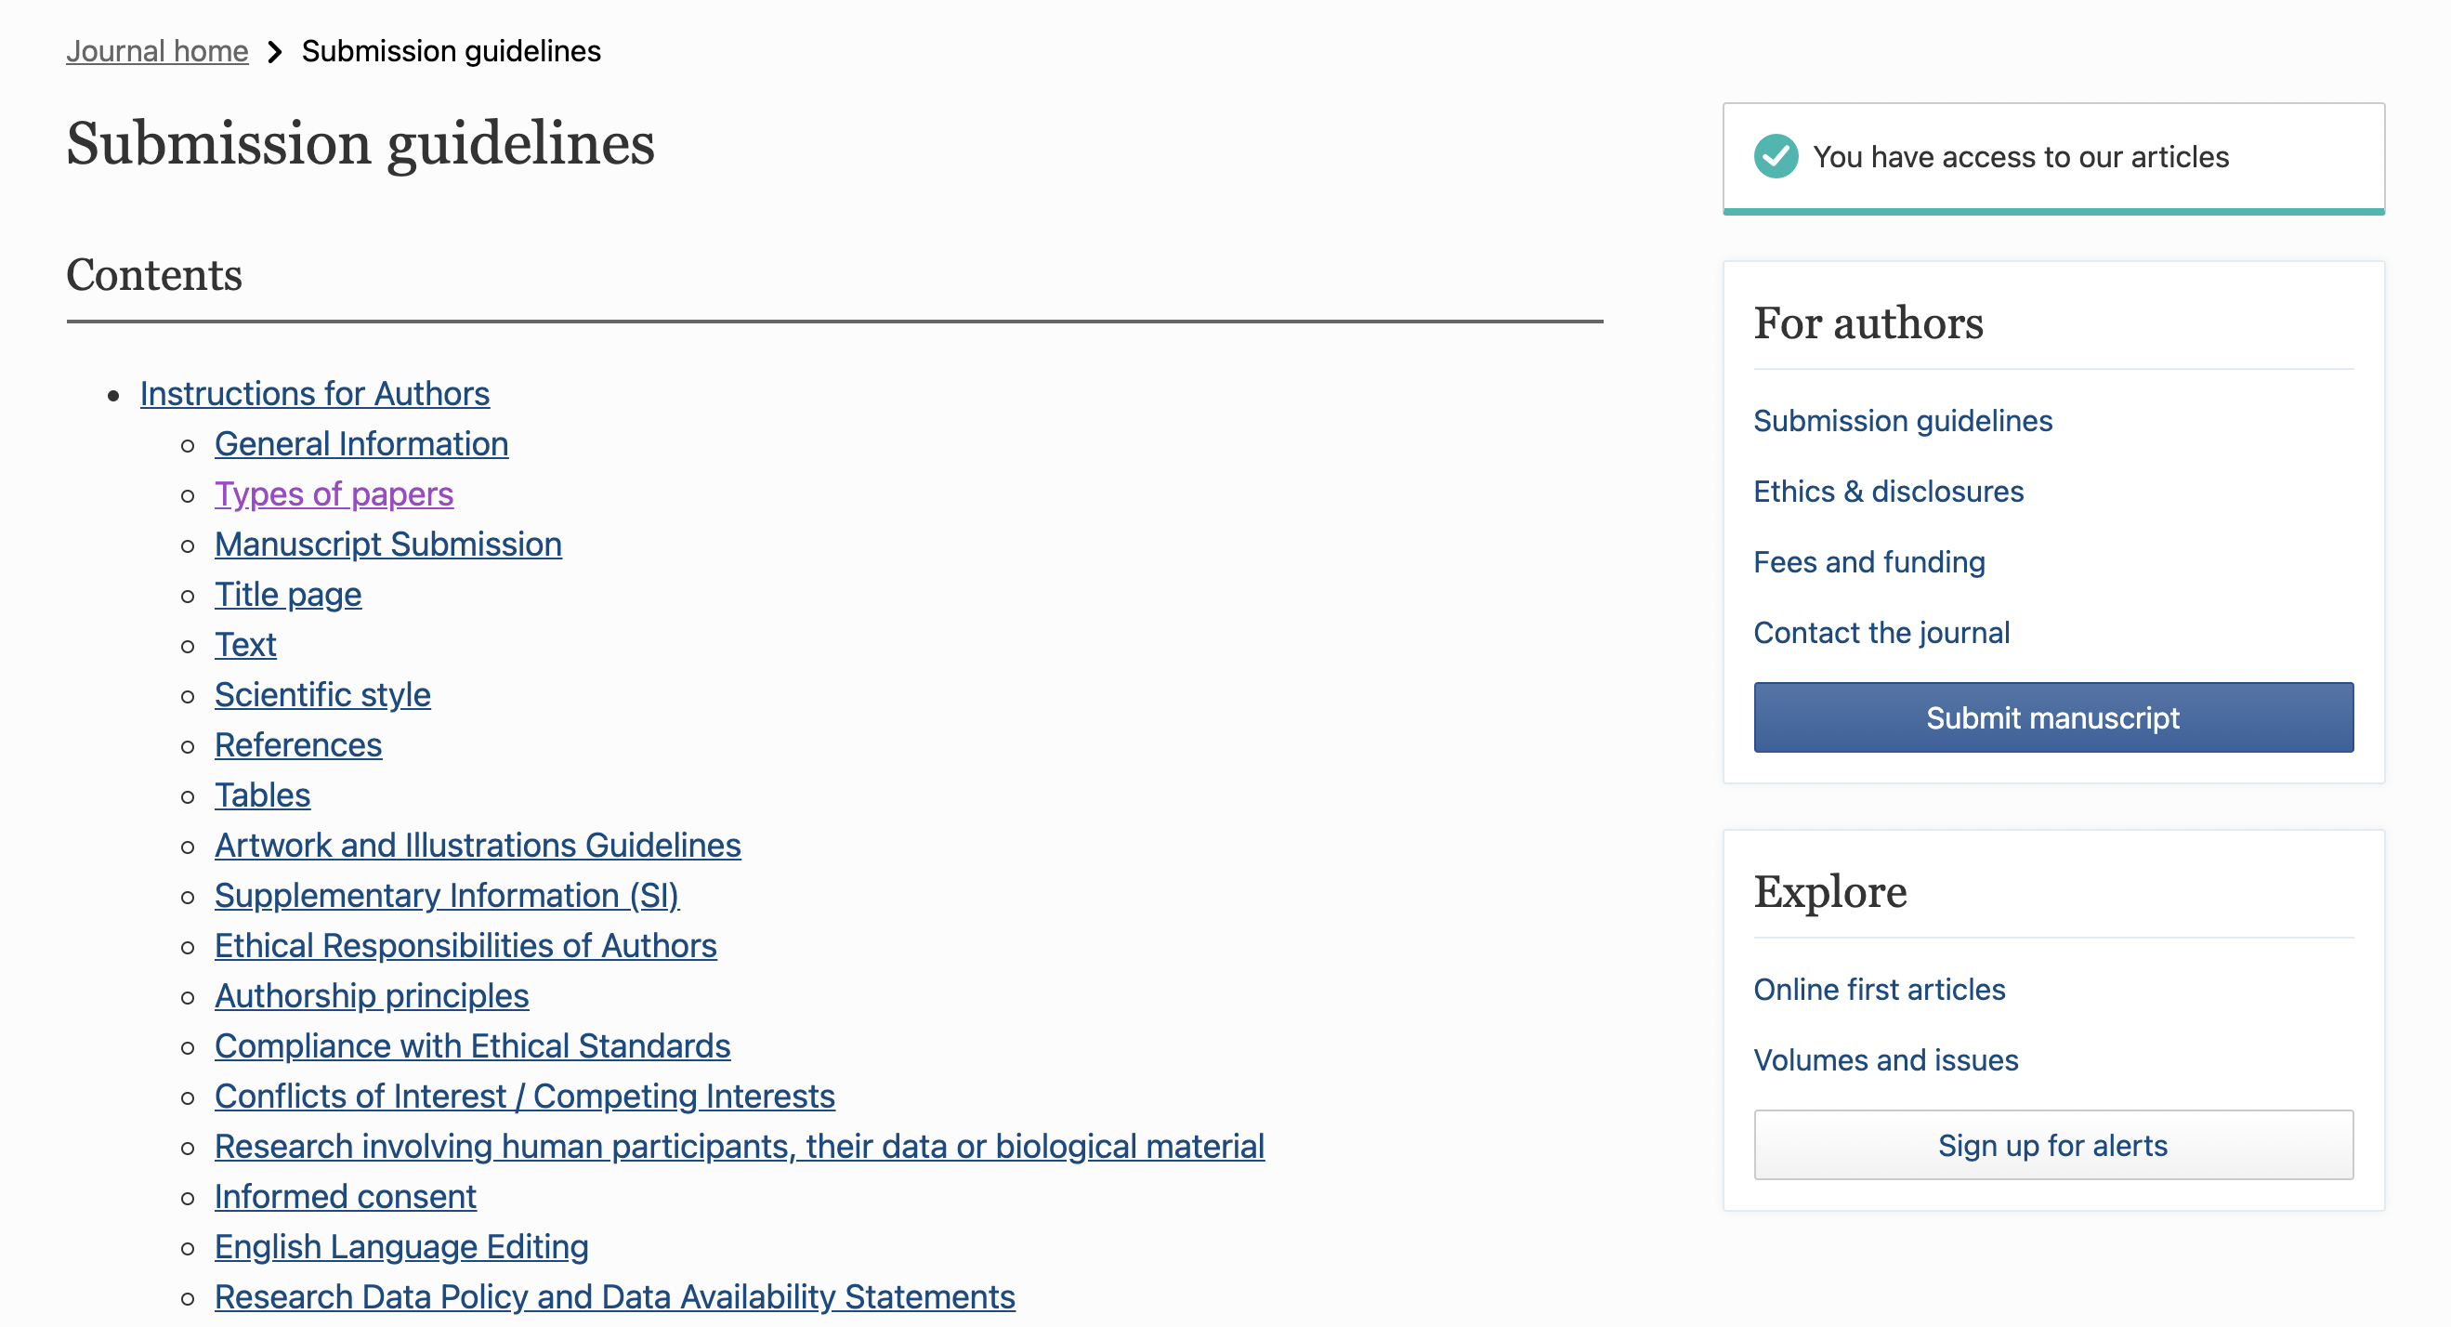
Choose a Journal
3. Follow the submission guidelines to submit your paper
USC Mark and Mary Stevens Neuroimaging and Informatics Institute
USC Laboratory of Neuroimaging
loni.usc.edu

Slide 5
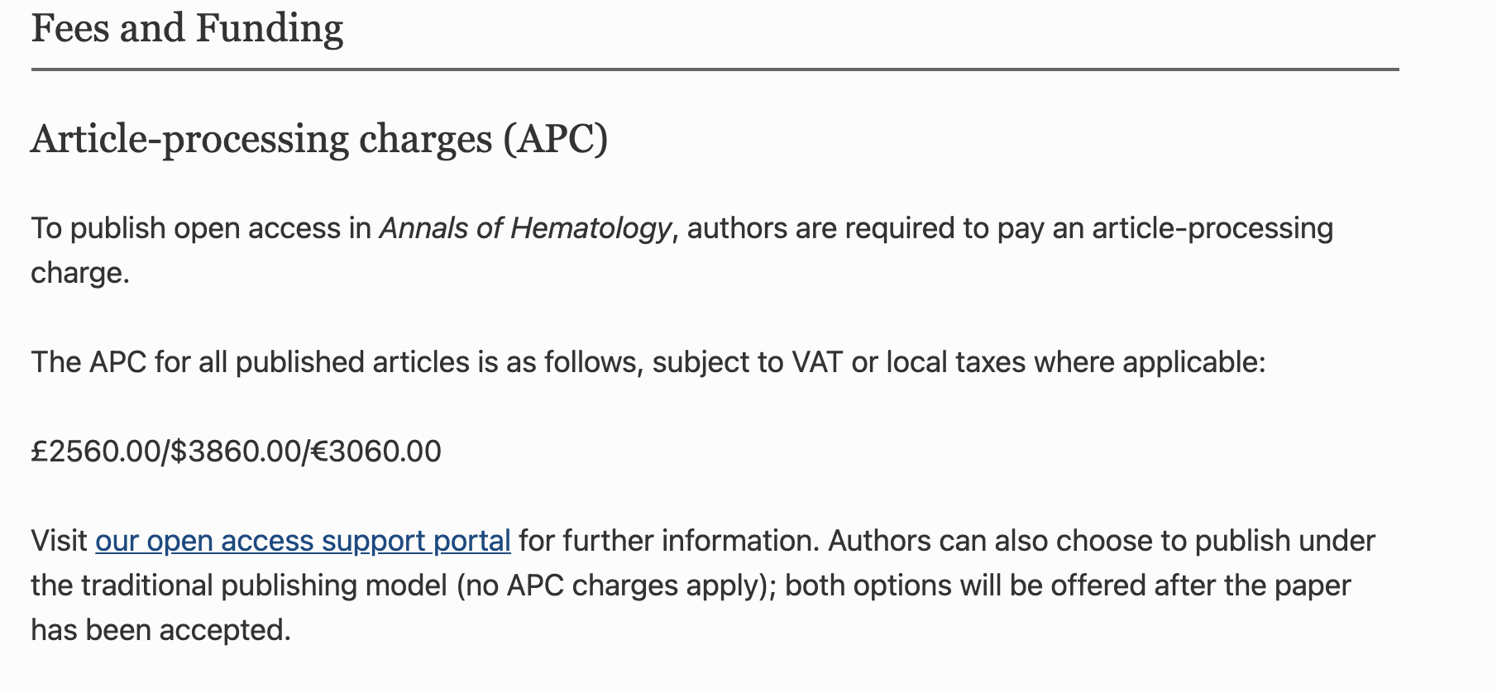
Choose a Journal
4. Fees and Funding
USC Mark and Mary Stevens Neuroimaging and Informatics Institute
USC Laboratory of Neuroimaging
loni.usc.edu

Slide 6
Submit a paper to a Journal
5. How long might it take when I hear their decisions?
It varies from journal to journal.
Be patient!
Do not be shy to send out follow-up emails
Possible decisions: Reject, Minor revision, Major revision, Accept (Accept without revisions is very rare but possible)
Paper Submitted
12/30/2020
Under Review
1/3/2021
Minor Revision Needed
2/7/2021
Revision Submitted
2/18/2021
Paper Published
3/8/2021
Paper Accepted
3/2/2021
USC Mark and Mary Stevens Neuroimaging and Informatics Institute
USC Laboratory of Neuroimaging
loni.usc.edu

Slide 7
Submit a paper to a Arxiv
Major use: disseminating manuscripts that you also publish in a journal or conference
To claim scientific priority: Delays at the journal end might lead to your research getting scooped. Publishing on arXiv lets the world know that you were the first one to come up with these results.
To get comments from peers: ArXiv allows others to comment on articles that are posted. This acts as an open peer review, where others in your field give feedback and suggest improvements that will help improve your paper and thereby increase your chances of acceptance by a journal. You can revise your paper based on these comments before submitting to a journal.
To give readers access to their article: Some articles are not widely read because readers don't have subscription to the article. Also, authors sometimes cannot afford the charges for publishing their article open access. In such cases, posting on arXiv ensures a wider readership and could even lead to more citations.
https://academia.stackexchange.com/questions/75325/why-do-people-publish-on-arxiv-instead-of-other-places
USC Mark and Mary Stevens Neuroimaging and Informatics Institute
USC Laboratory of Neuroimaging
loni.usc.edu

Slide 8
Submit a paper to a Journal
What if I am rejected by a journal?
First of all, it is common to be rejected. Do not be sad or disappointed with yourself!
Reason for rejection are a lot:
Your topic did not fall in their aims or scope.
Your paper did not seem interesting to them.
Your format does not match their requirements
…… ,etc.
Make the recommended changes based on their comments
Find another journal and submit
* Impact Factor is not the only criteria for choosing a journal!
USC Mark and Mary Stevens Neuroimaging and Informatics Institute
USC Laboratory of Neuroimaging
loni.usc.edu

Slide 9
Thank you, Laboratory of Neuro Imaging (LONI), for this great opportunity!
This work was supported by the National Science Foundation under Award Number 2027456 (COVID-ARC)

